Slide 1
COMPANY NAME
Trustable Software Engineering
Edinburgh 12 June 2019
Amanda Brock, CEO

Slide 2
Risks in Software Engineering
Death and Personal Injury
Damage to Property – tangible and intangible
Financial Losses
Intellectual Property
Damage to reputation
Regulatory breach

Slide 3
Eating The Elephant in the room Elevator Pitch
"If an elevator was to fall and crash into the floor due to mechanical or civil engineering failure, our families and friends would expect that subsequently it would be possible to establish what had gone wrong, which standards and laws were broken, and who was accountable.
If the same accident were to happen as a result of problems in software controlling a fleet of elevators in a building, it is extremely unlikely that we could establish what regulations applied, let alone who was accountable.
Almost all high-tech elevator pitches in recent decades have been built on immature software industry practices which are unregulated and provide no evidence to justify our trust. The Trustable Software project is working with engineering, legal, compliance and insurance communities to establish a broadly useful framework for evidence-based assessment of the risks associated with creation and use of critical software."

Slide 4
2016 Response: Project set up
“We propose that software can be considered trustable if
we know where it comes from
we know how to build it
we can reproduce it
we know what it does
it does what it is supposed to do
we can update it and be confident it will not break or regress
we have some confidence that it won't harm our communities and our children”

Slide 5
COMPANY NAME
The Trustable Software Project 2019

Slide 6
UK not for profit entity
Trustable Software Ltd, not for profit
Community of Contributors
(Advisory) Board
Corporate Sponsors

Slide 7
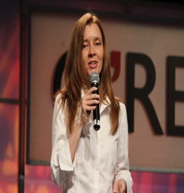
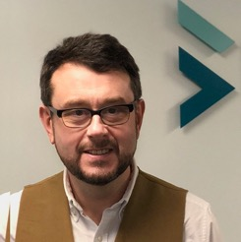
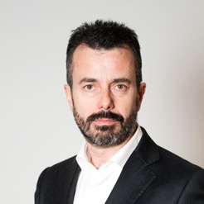
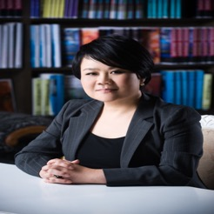
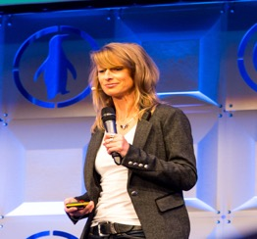
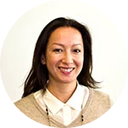
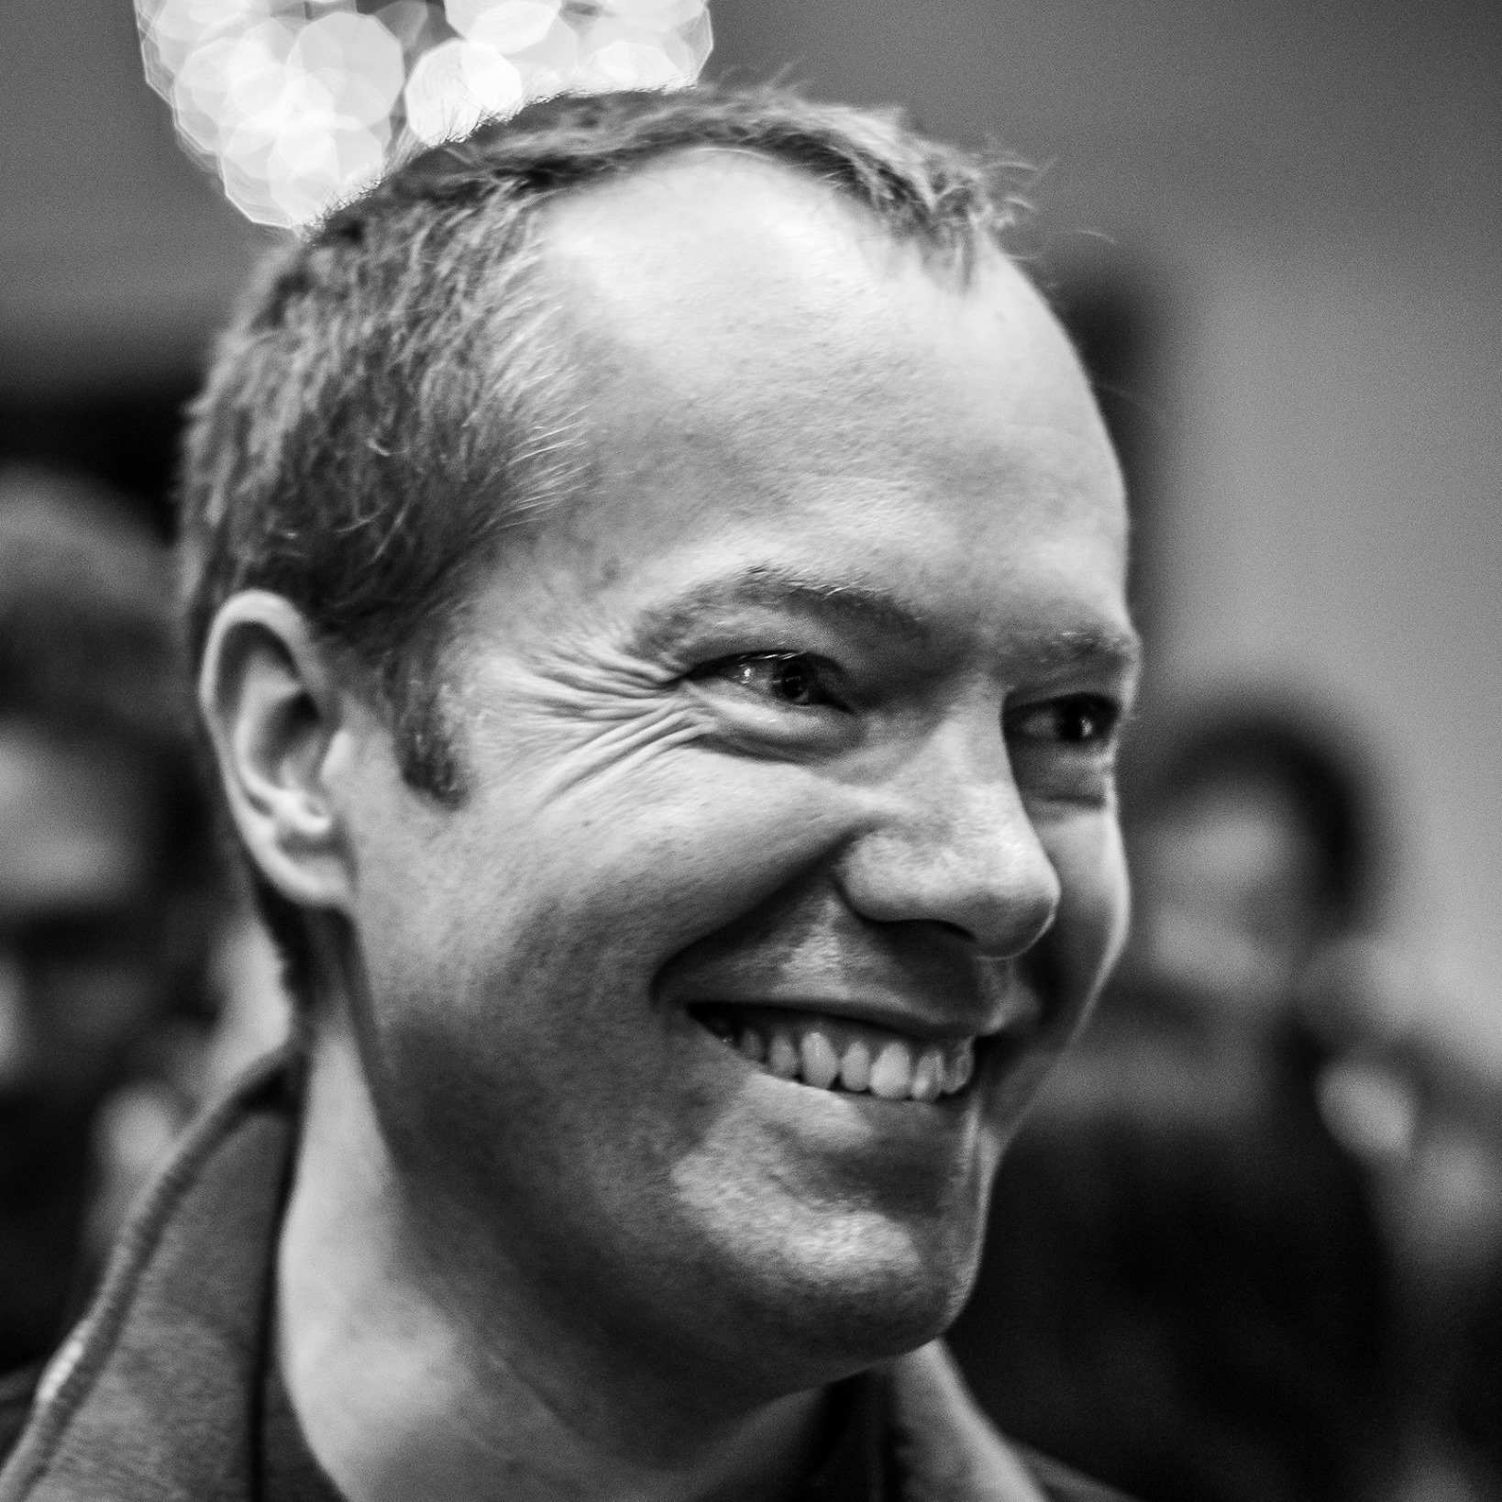
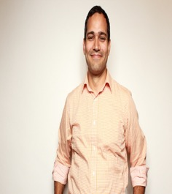
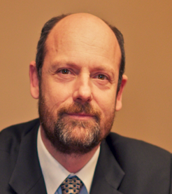
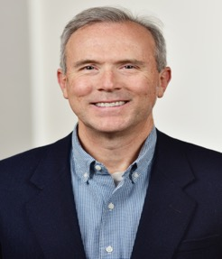
Advisory Board
2
3
4
5
Andrew Katz
Jaclyn Tsai
Jilayne Lovejoy
Allison Randal
Carlo Piana
Luis Villa
Malcolm Bain
McCoy Smith
Sachiko Muto
Shane Coughlan

Slide 8
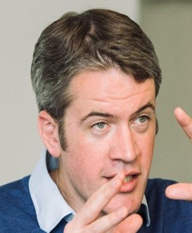
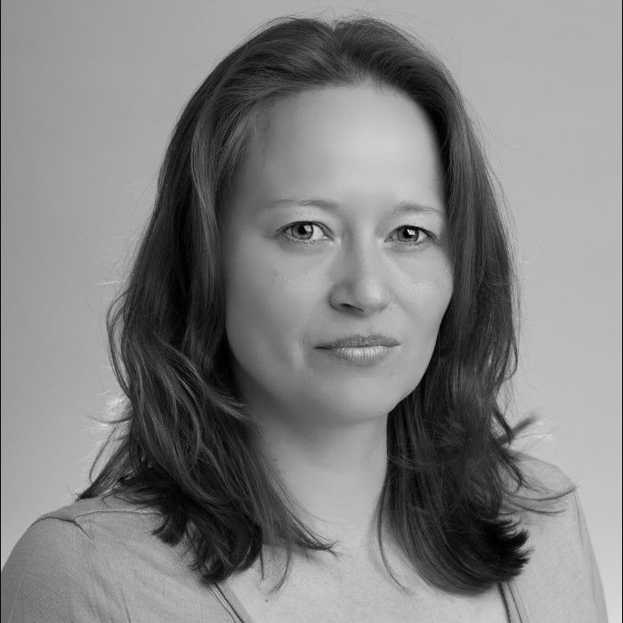
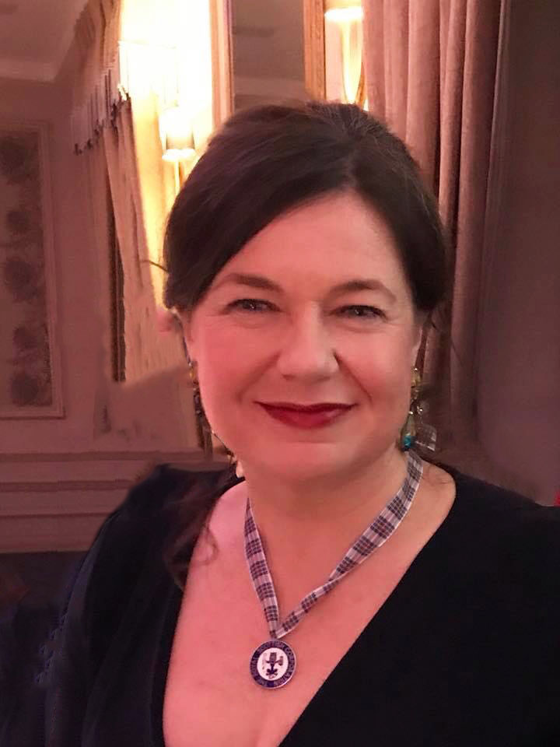
Staff
Toby Crick
External Counsel
Alex Boehm Operations Manager
Amanda Brock
Chief Executive

Slide 9
Trustable Software Engineering Structure
Methodology&
Processes
Library of Measurements, Metrics &Evidence
Legal & Compliance Requirements
Broker
Software Engineering and development
Trustable
Insurance
Insurer
Vendor
Users and consumers
Audit
Captive or similar

Slide 10
Seeking Global Sponsorship and funding

Slide 11
Trustable Roadmap
03/2019
04/2019
1/2020
Trustable entity and CEO
4 work streams, build community and research
Move to an elected Board
01/2016
03/2019
07/2019
Trusatable engineering project established
Advisory Board
Seeking funding

Slide 12
Work Streams of Community Contributors:
“Engineering”
Evidence collection, analysis, metrics – “Process”
Example processes, projects, tools – “Public Constraints”
“Insurance and Risk”
Measurements
Liability
Insurance
“Legal and Compliance”
Laws, regulations, standards and governance

Slide 13
2019 Engineering Work Streams
Process work stream: – pick up on existing debate, to build a common set of formal vocabulary to describe every possible process to create, integrate, and deliver software, focused on methods of audit regarding whether particular claims are supported, process agnostic
Provenance: attestation and attribution of origin for each component
Construction: statement of process for reproducible construction
Function: claims of expected behaviours and honoured prohibitions
Maintenance: future updates will not cause issues.
Public Constraints work stream:
consider specific software use cases

Slide 14
2019 Insurance Work Stream
Insurance work stream:
Consider what risks there are
Consider what heads of insurance apply
Consider access to insurance at required levels
Look at a single insurance product across software
Manage costs or insurance risk through a Pool Captive or similar
Manage access to the right support in litigation and better case law
Build a safer environment through insurance
Discussions with London market

Slide 15
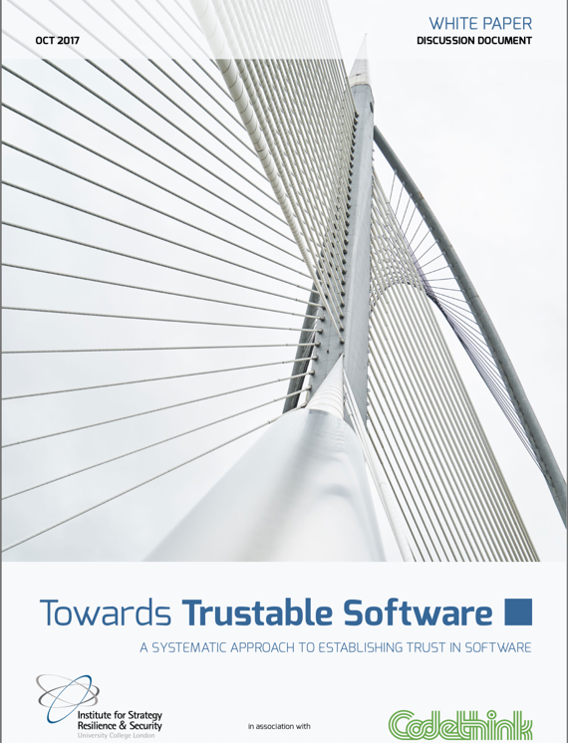
Building a body of white papers, as a home for state of the art information

Slide 16
Thank you – questions?
Amanda.brock@trustable.io
@amandabrockUK
+447718516954
www.trustable.io
@trustableio

